Slide 1
WATER QUALITY MONITORING SYSTEM
USING IOT
UROP TEAM(GRP NO. 51)
G. Sidhardha - AP18110020036
K. Shanmukh datta -AP18110020046
K. Kushwant Sai -AP18110020054
G. Divyesh Sai - AP18110020066
CH.Rajesh - AP18110020068

Slide 2
INTRODUCTION
Water is the nature’s gift among the elements of life to all the living beings on earth.
Water is contaminated everywhere due to human activities such as industrial waste so we need to save water.
Our system deals with percentage of various parameters involved in water is fit for drinking or not.
As there is increase in water pollution, there is need of controlling the pollution in water by monitoring water levels to prevent diseases in real time.

Slide 3
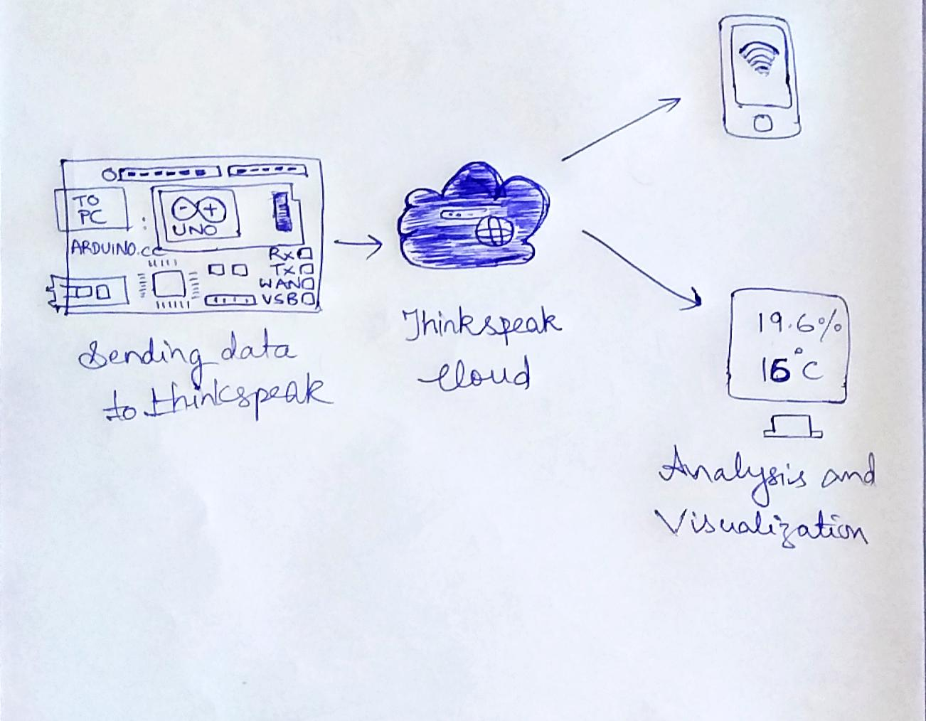
OBJECTIVE
The main objective of our project is to obtain the water samples and collect readings based on parameters.
The stored information of the samples taken in the cloud with the help of wifi module is transferred to mobile application.

Slide 4
MOTIVATION
To make our natural habitat pollution-free by maintaining level of turbidity, salinity in water bodies clean time to time.
In recent times, we observed manual checking of water quality as expensive and time-consuming, to reduce this constraints we have worked on WQM.
At present the systems used are unable to monitor different water parameters, present in water by using traditional methods of technology.

Slide 5
REQUIREMENT ANALYSIS
Arduino ATMEGA328
ESP8266 Serial Esp-01 WIFI Wireless
Turbidity sensor
Conductivity Sensor
Temperature Sensor
16X2 LCD Display
Step down Transformer(230v/12v-0-12v 500mA)
Buzzer Driver
Analog to Digital Converter
Voltage Regulator (7805)
Relay or Mechanical switch
Buzzer
Crystal Oscillator
PCB Board
2 Diodes(1N4007)
Resistors(1k, 10k)
LEDs, IR and photodiode sensors
POWER USB, POWER JACK

Slide 6
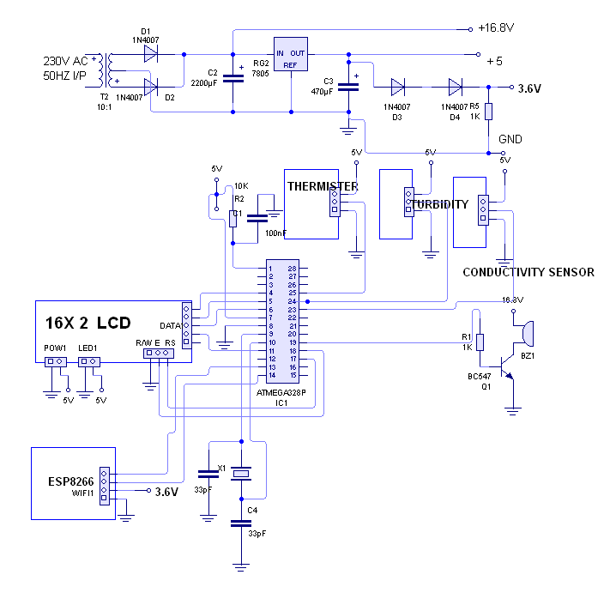
DESIGN MODEL(SCHEMATIC)

Slide 7
BLOCK DIAGRAM
RESET
TEMPERATURE SENSOR
BUZZER DRIVER
BUZZER
ARDUINO
AT MEGA 328P
CONTROLLER
16X2
DISPLAY
CONDUCTIVITY
SENSOR
MOBILE
CLOUD
IOT
Turbidity
Led-LDR
ESP 8266
Wi-Fi
MODEM
OSCILLATOR

Slide 8
APPLICATIONS
WQM Applications :
Aquaculture
Drinking water
Ground water
Waste water
Prevention of Legionella bacteria in building plumbing system with IoT flow monitoring.

Slide 9
LIMITATIONS
The system has a high complexity and exhibits low performance.
Malfunctioning of hardware devices.

Slide 10
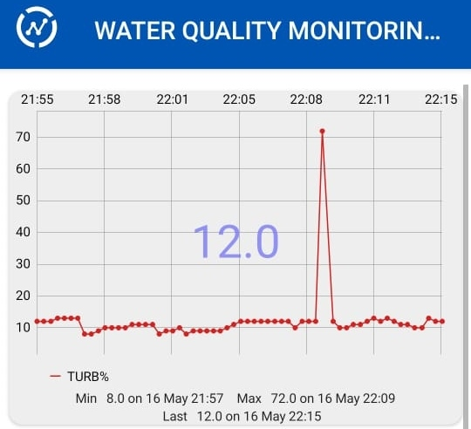
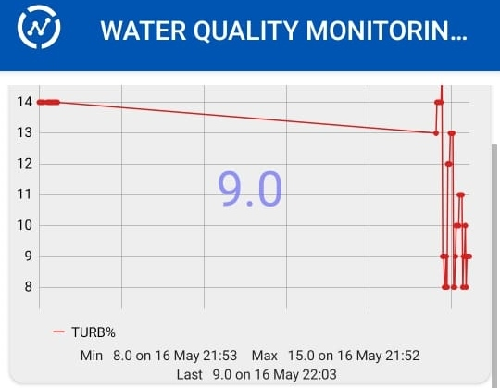
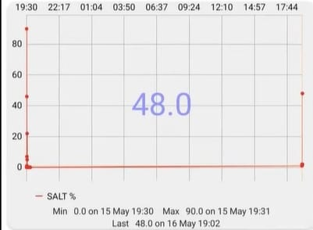
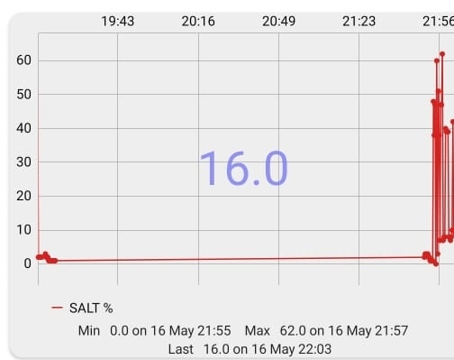
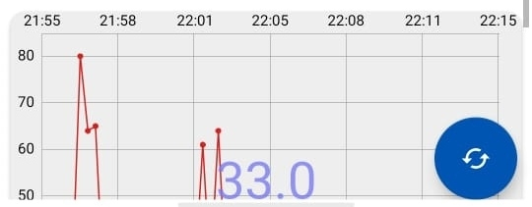
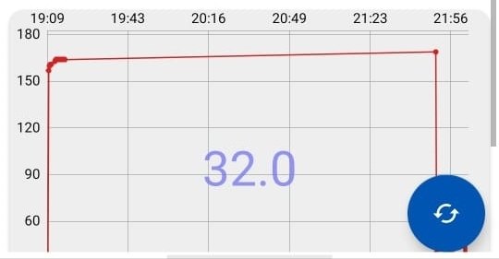
RESULTS
SAND WATER VS
DRINKING WATER

Slide 11
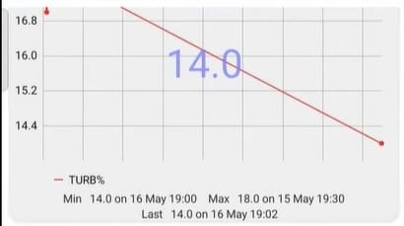
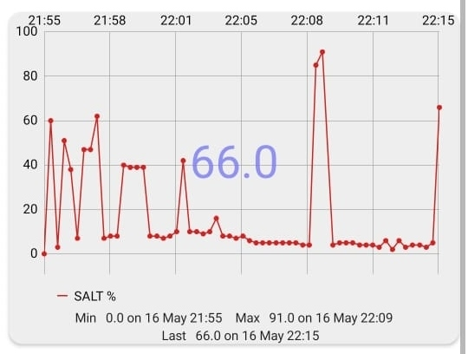
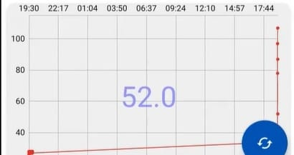
SALINITY OF SALT WATER
TURBIDITY OF MUD WATER
TEMPERATURE OF HOT WATER

Slide 12
FUTURE SCOPE
Our future works can be focused on system using more number of sensors.
We can add GPS modem and pH value sensor in real time monitoring.
In future, work can be done on large number of dataset considering the chemical parameters present in water sample.
Our future goal of this project is to improve supply of water by monitoring the quality of water comparing with standard values.

Slide 13
CONCLUSION
In this project, the quality of water is monitored successfully using modules like PC (wifi-module) and IDE for transferring information and tracking techniques respectively.
The implementation enables online data to consumers.
The ultimate goal of the project is to observe the quality of water samples by designing a water quality monitoring system in IOT platform that can detect three specific water parameters such as
Turbidity
Conductivity
Temperature

Slide 14
THANK YOU!

